Slide 1



Slide 2

Content
What is React Native?
Why Use React Native ?
Environmental Setup of React Native/System Requirement of React Native
Application of React Native
React Native Component
Example of React Native
Project Output
Summary

Slide 3

REACT NATIVE
React Native is a JavaScript framework that is used to develop mobile applications for iOS and Android.

Slide 4


React Native
It uses only JavaScript to build a mobile application.
Facebook develops the React Native in 2013.
It was released publically in January 2015 as React.js, and in March 2015, Facebook announced that React Native is open and available on GitHub.
4

Slide 5


React Native Features
React − This is a Framework for building web and mobile apps using JavaScript.
Native − You can use native components controlled by JavaScript.
Platforms − React Native supports IOS and Android platform.
5

Slide 6

Why we use React Native
Cross Platform
One of the most significant advantages of React Native is that you can develop an application for both Android and iOS ecosystems simultaneously by writing the same code with just a few modifications for each platform.
Performance
It also facilitates a hot reloading feature that makes sure that small changes done to the application are immediately visible to the developer.
Large Developers’ Community
A huge developers’ community ensures that all the queries are resolved in time, and therefore, adequate support is available for the React Native framework.
Excellent Career Opportunities
React Native has become very popular lately due to advantages like cross-compatibility.

Slide 7

Environmental Setup of React Native/System Requirement of React Native
Node JS
JDK 1.8
Android Studio / IOS
React-Native CLI
Yarn Package Manager
Visual Studio Code (Optional)

Slide 8


Application of React Native
Facebook
Skype
Walmart
Adidas
Tesla
WhatsApp Messenger
8

Slide 9




Component of React Native
1. Basic Component
View
Text
Image
Text Input
Scroll View
Button , etc.
User Interface
List View
IOS Component and APIs
Android Component and APIs
9

Slide 10


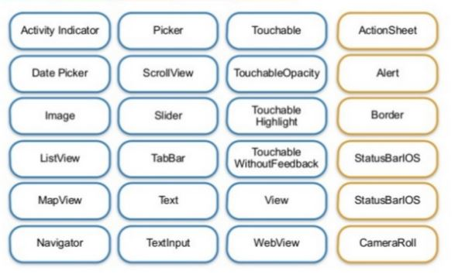
.
10

Slide 11


Step to Create React Native
Npm install -g react-native-cli
React-native init Project Name
React-native start // to compile
React-native run-android // to run on device
Emulator –avd your emulator name
11

Slide 12



Example Of React Native
Import React, {Component } from ’react’;
Import { View, Text, Stylesheet } from ‘react-native’;
Export default class App extends Component {
render() {
Return(
<View style={styles. Container}>
<Text style={styles.Intro}> Hello World </Text>
</View>
);
}
}
Const styles = Stylesheet. Create {
Container: {
Flex: 1
},
Intro : {
Font Size: 12,
Color: “ yellow ”
} }
Flex :1 // container will expand full available width
12

Slide 13

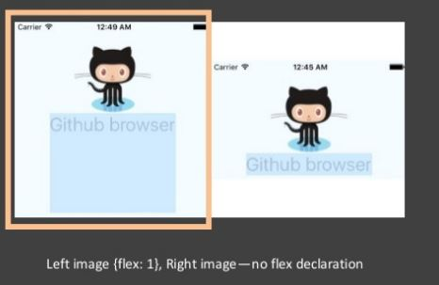
Example Of React Native
13

Slide 14

React Native Code Explanation
import React, {Component} from 'react': imports the library and other components from react module and assign then to variable React.
export default class App extends Component: defines the classes that extend the React Component. The export default class modifier makes the class "public". This block of code defines the components that represent the user interface.
render(): a function that returns a React element.
return(): returns the result of layout and UI components.
View: a container that supports the layout accessibility controls. It is a fundamental component for building the UI.
Text: a React component for displaying text.
style: a property used for styling the components using StyleSheet.
styles: used to design individual components. For example:
{styles.instructions}>{instructions}:
const styles = StyleSheet.create({}): The StyleSheet class creates the style object that controls the layout and appearance of components. It is similar to Cascading Style Sheets (CSS) used on the Web.
14

Slide 15
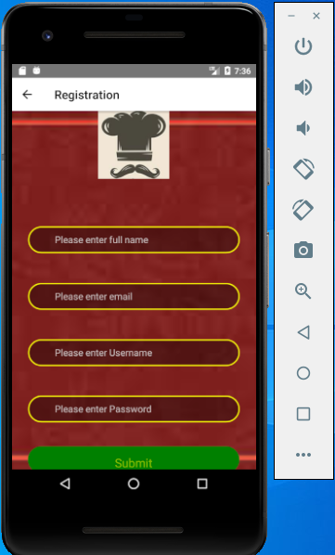

Project Output
15

Slide 16
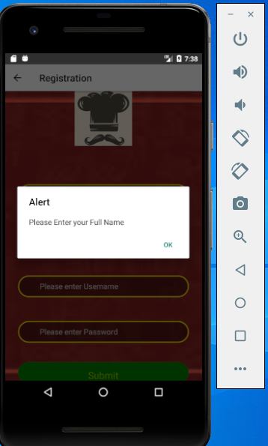

Project Output
16

Slide 17
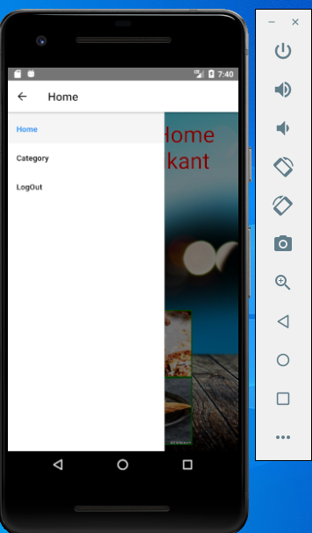

Project Output
17

Slide 18
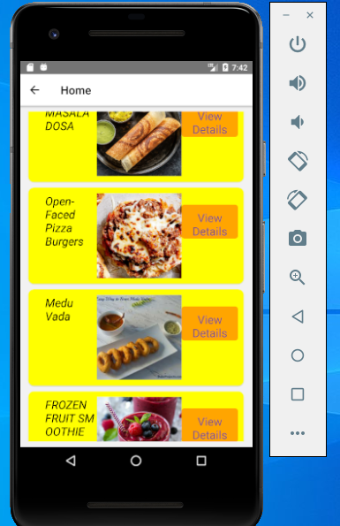
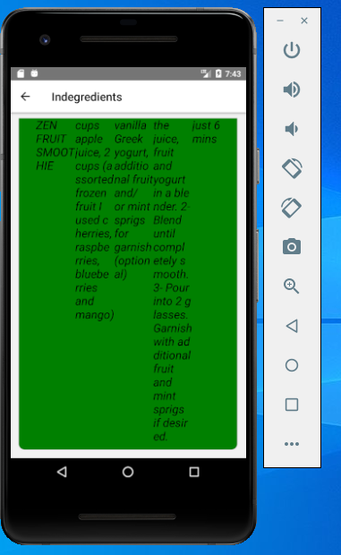
Project Output

Slide 19


Summary
React Native is a JavaScript framework that is used to develop mobile applications for iOS and Android.
React Native is amazing for JavaScript developers who want high flexibility and ability to build mobile apps with a powerful JavaScript Interface.
19

